Slide 1




Counting

Slide 2
Homework Review
Take a few moments to share your solutions to Homework 10

Slide 3

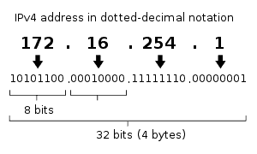
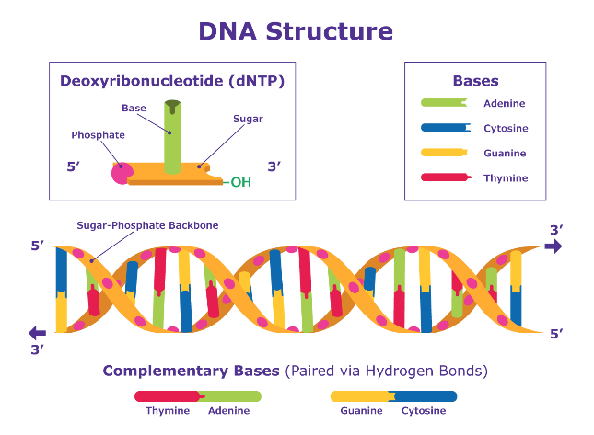
Learning how to count...again
Combinatorics – The study of the arrangement of objects
Enumeration – Counting of objects with certain properties
First came up in the study of gambling in the 1600s
Counting objects can be used to solve many problems:
How complex is this algorithm?
How many telephone numbers needed for a given population?
How many IP addresses do we need for a given region?
How complex does a password need to be?
DNA sequencing
Rosen, Kenneth. Discrete Mathematics and Its Applications, 7th Edition. McGraw-Hill, 2012

Slide 4
Tips
Play with the problem.
Try a different approach.
There is usually more than one way to arrive at the same solution.
Do as many problems as you can. Try all the additional exercises.

Slide 5
Two basic counting principles
Product Rule
Sum Rule
Rosen, Kenneth. Discrete Mathematics and Its Applications, 7th Edition. McGraw-Hill, 2012

Slide 6

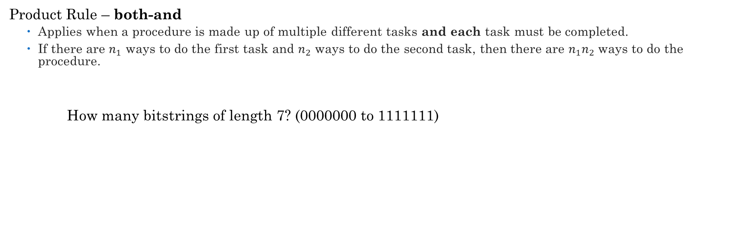
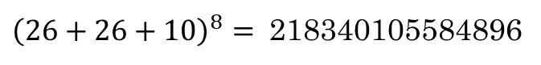
Product Rule
Product Rule – both-and
Applies when a procedure is made up of multiple different tasks and each task must be completed.
If there are $n_{1}$ ways to do the first task and $n_{2}$ ways to do the second task, then there are $n_{1}n_{2}$ ways to do the procedure.
How many bitstrings of length 7? (0000000 to 1111111)
_ | _ | _ | _ | _ | _ | _
1 or 0 | 1 or 0 | 1 or 0 | 1 or 0 | 1 or 0 | 1 or 0 | 1 or 0
2 | 2 | 2 | 2 | 2 | 2 | 2
* | * | * | * | * | *
$$= 2^{7}= 128$$
How many passwords of length 8? (Including uppercase, lowercase, digits)
${\left(26+26+10\right)}^{8}=$ 218340105584896
Rosen, Kenneth. Discrete Mathematics and Its Applications, 7th Edition. McGraw-Hill, 2012

Slide 7
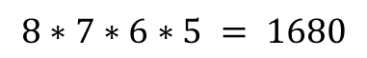
Product Rule - Example
Let's play musical chairs?
Suppose we have a function assigning 4 students to 8 possible seats.
Is this function One-to-one? Onto?
How many ways to assign the seats?
Ann: 8 ways to assign a seat
Bob: 7 remaining ways to assign a seat
Carl: 6 remaining ways to assign a seat
Deb: 5 remaining ways to assign a seat
Seat 1
Ann
Seat 2
Seat 3
Bob
Seat 4
Carl
Seat 5
Deb
Seat 6
Seat 7
Seat 8
$$8∗7∗6∗5 = 1680$$

Slide 8
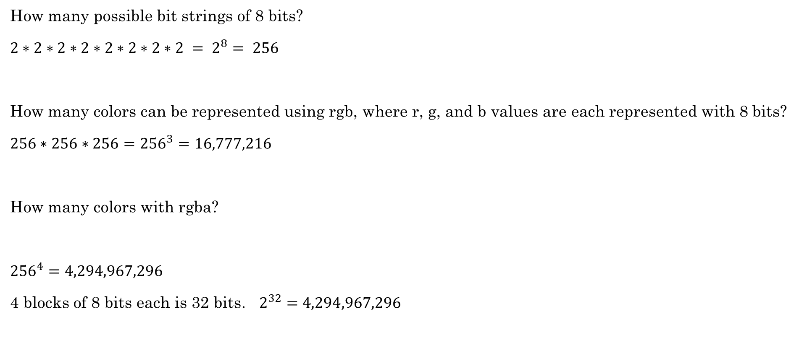
How many?
How many possible bit strings of 8 bits?
$2∗2∗2∗2∗2∗2∗2∗2 = 2^{8}= 256$
How many colors can be represented using rgb, where r, g, and b values are each represented with 8 bits?
$256∗256∗256={256}^{3}=16,777,216$
How many colors with rgba?
${256}^{4}=4,294,967,296$
4 blocks of 8 bits each is 32 bits. $2^{32}=4,294,967,296$

Slide 9

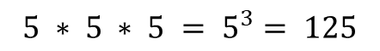

How many functions?
How many possible different functions map from a set with three elements to a set with five elements?
1
2
3
4
5
$$5 ∗ 5 ∗ 5 = 5^{3}= 125$$
5
5
5
a
b
c
5
4
3
How many different one-to-one functions?
$$5 ∗4 ∗3 =60$$
How many different onto functions?
None, there are only three elements in the domain but five in the codomain.
range $≠$ codomain

Slide 10
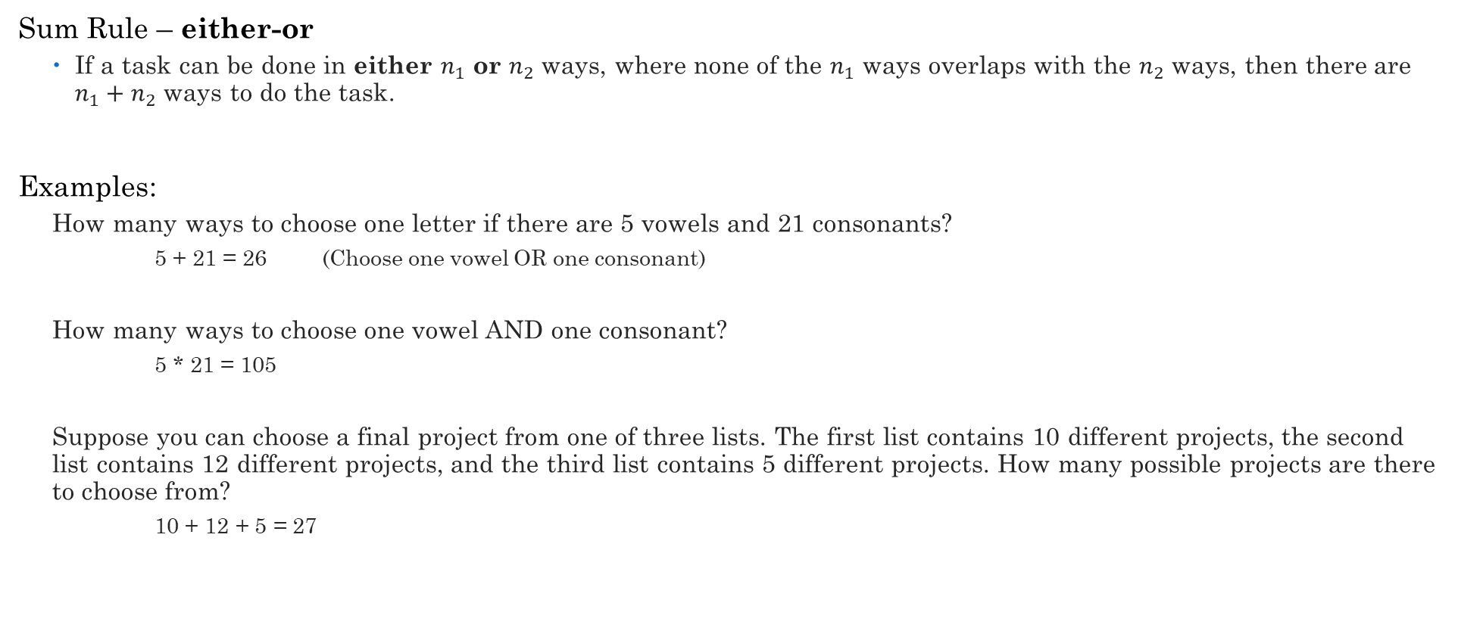
Sum Rule
Sum Rule – either-or
If a task can be done in either $n_{1}$ or $n_{2}$ ways, where none of the $n_{1}$ ways overlaps with the $n_{2}$ ways, then there are $n_{1}+n_{2}$ ways to do the task.
Examples:
How many ways to choose one letter if there are 5 vowels and 21 consonants?
5 + 21 = 26 (Choose one vowel OR one consonant)
How many ways to choose one vowel AND one consonant?
5 * 21 = 105
Suppose you can choose a final project from one of three lists. The first list contains 10 different projects, the second list contains 12 different projects, and the third list contains 5 different projects. How many possible projects are there to choose from?
10 + 12 + 5 = 27
Rosen, Kenneth. Discrete Mathematics and Its Applications, 7th Edition. McGraw-Hill, 2012

Slide 11







Practice
How many possible license plates are there given the following constraints:
Each character can be a capital letter or a digit except for 0 and 1.
Must have 7 characters.
Must begin with a letter.
Examples:
M239ABC
AD8Y7D4
Q893262
____ ____ ____ ____ ____ ____ ____
$$26$$
$$34$$
$$34$$
$$34$$
$$34$$
$$34$$
$$34$$
$$26∗34∗34∗34∗34∗34∗34=26∗{34}^{6}=40,164,914,816$$

Slide 12
Bijection Rule
Let S and T be two finite sets. If there is a bijection from S to T, then |S| = |T|.
What does bijection mean?
K-to-1 Rule:
Suppose there is a k-to-1 correspondence from a finite set A to a finite set B. Then |B| = |A|/k.
A bijection is a 1-to-1 correspondence

Slide 13
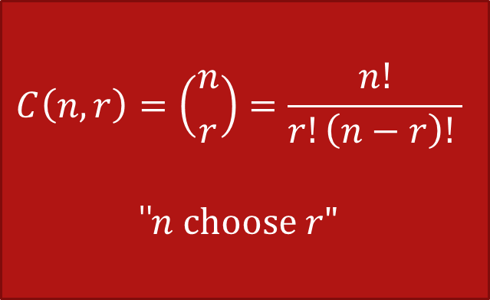
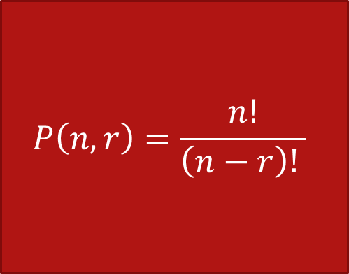
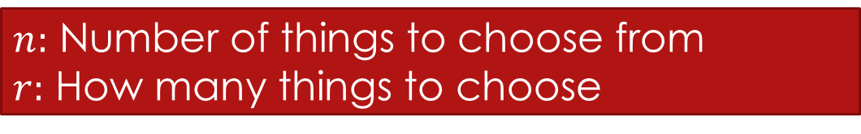
r-Permutations vs r-Combinations (Subsets)
$n:$ Number of things to choose from
$r:$ How many things to choose
Order matters
Order does not matter
$$P\left(n,r\right)=\frac{n!}{\left(n−r\right)! }$$
$$C\left(n,r\right)=\left({n \atop r}\right)=\frac{n!}{r!\left(n−r\right)! }$$
"$n choose r"$
Think sequence or arrangement
Think sets

Slide 14





r-Permutations
Order matters
Example:
How many ways can we select three students to stand in line for a picture from a group of five students?
5 * 4 * 3 = 60
Rosen, Kenneth. Discrete Mathematics and Its Applications, 7th Edition. McGraw-Hill, 2012

Slide 15

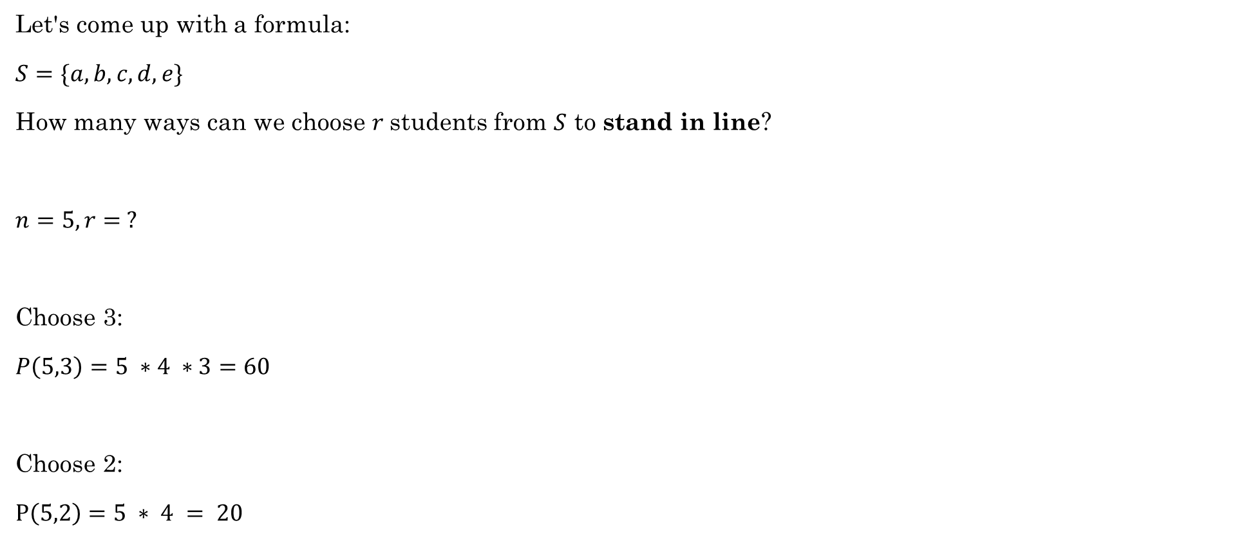
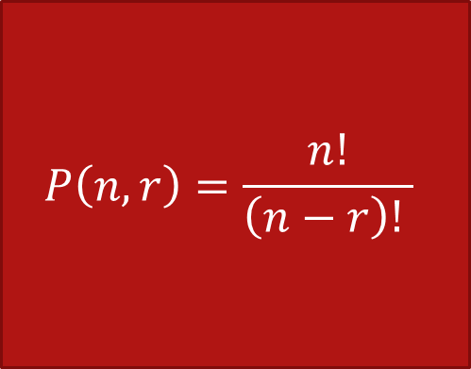

r-Permutations
Does order matter?
Let's come up with a formula:
$S=\{a, b, c, d, e\}$
How many ways can we choose $r$students from $S$ to stand in line?
$n=5, r= ?$
Choose 3:
$P\left(5,3\right)=$ $5 ∗4 ∗3=60$
Choose 2:
$P\left(5,2\right)=5 ∗ 4 = 20$
$$P\left(n,r\right)=\frac{n!}{\left(n−r\right)! }$$
/
/
$$\frac{5∗4 ∗3 ∗2 ∗1}{2 ∗1}=\frac{5!}{(5−3)!}=\frac{5!}{2!}=\frac{120}{2}=60$$
/
/
/
/
/
$$\frac{5∗4 ∗3 ∗2 ∗1}{3 ∗ 2 ∗1}=\frac{120}{6}=20$$
/
/
/

Slide 16

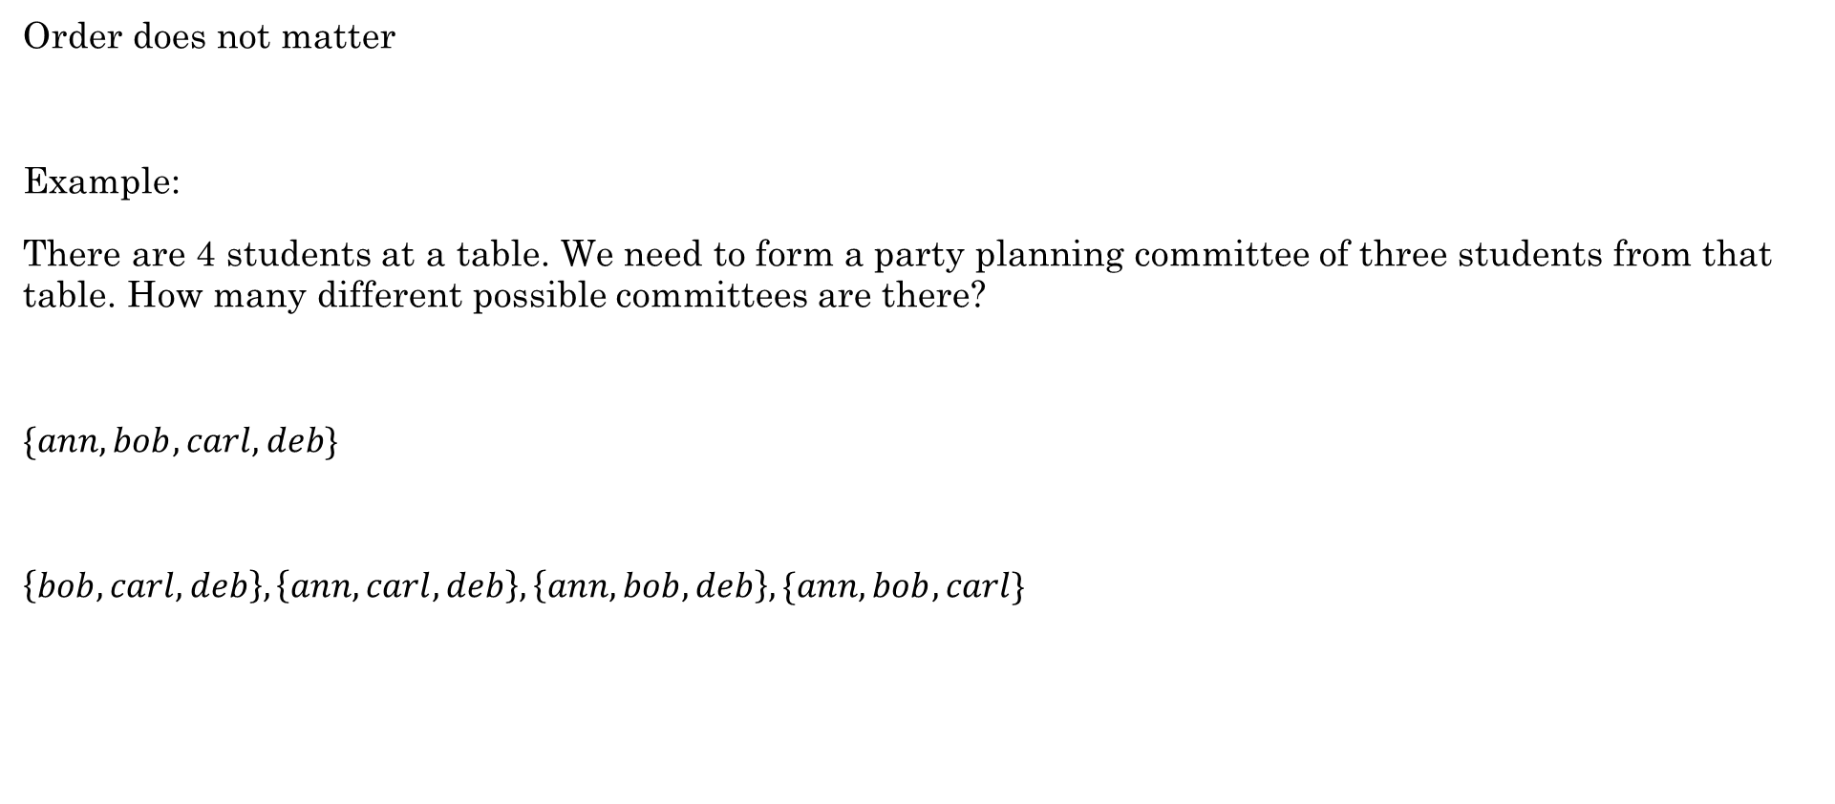
r-Combinations (AKA Choosing AKA Subsets)
Order does not matter
Example:
There are 4 students at a table. We need to form a party planning committee of three students from that table. How many different possible committees are there?
$\{ann, bob, carl, deb\}$
$\left\{bob, carl, deb\right\}, \left\{ann, carl, deb\right\}, \left\{ann, bob, deb\right\}, \{ann, bob, carl\}$
Rosen, Kenneth. Discrete Mathematics and Its Applications, 7th Edition. McGraw-Hill, 2012

Slide 17
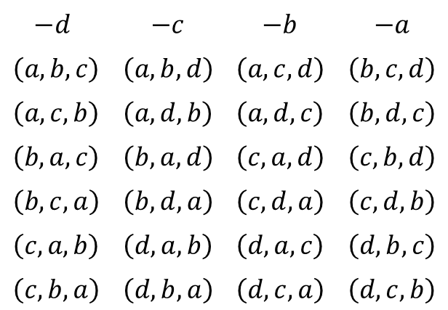
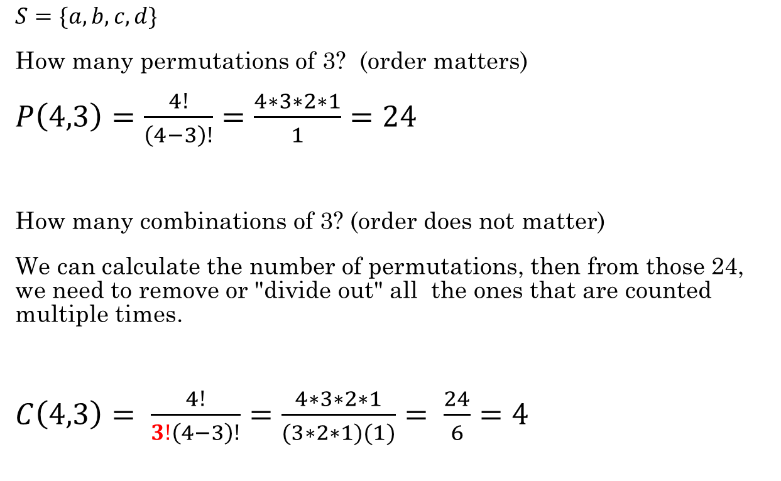
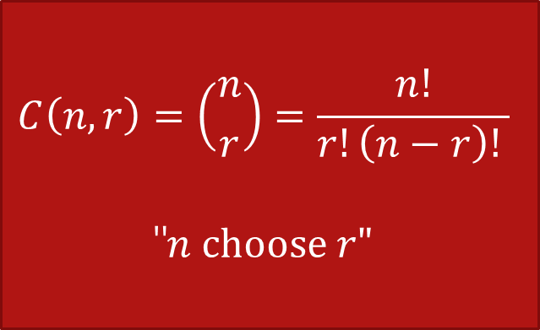
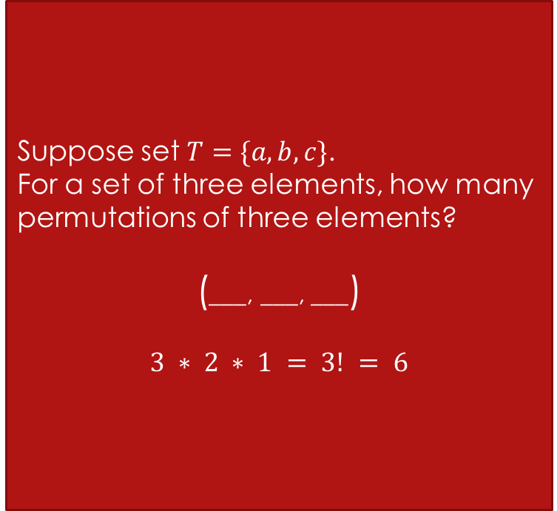
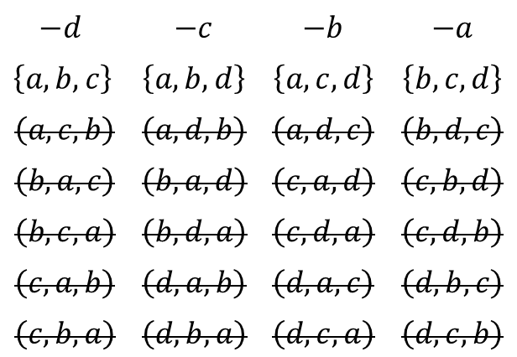
r-Combinations
Suppose set $T=\{a,b,c\}$.
For a set of three elements, how many permutations of three elements?
(___, ___, ___)
$$3 ∗ 2 ∗ 1 = 3! = 6$$
$$−d$$ | $−c$ | $−b$ | $−a$
$$\left(a,b,c\right)$$ | $\left(a,b,d\right)$ | $\left(a,c,d\right)$ | $\left(b,c,d\right)$
$$\left(a,c,b\right)$$ | $\left(a,d,b\right)$ | $\left(a,d,c\right)$ | $\left(b,d,c\right)$
$$\left(b,a,c\right)$$ | $\left(b,a,d\right)$ | $\left(c,a,d\right)$ | $\left(c,b,d\right)$
$$\left(b,c,a\right)$$ | $\left(b,d,a\right)$ | $\left(c,d,a\right)$ | $\left(c,d,b\right)$
$$\left(c,a,b\right)$$ | $\left(d,a,b\right)$ | $\left(d,a,c\right)$ | $$\left(d,b,c\right)$$
$$\left(c,b,a\right)$$ | $\left(d,b,a\right)$ | $\left(d,c,a\right)$ | $$\left(d,c,b\right)$$
$S=\{a,b,c,d\}$
How many permutations of 3? (order matters)
$P\left(4,3\right)=\frac{4!}{\left(4−3\right)!}=\frac{4∗3∗2∗1}{1}=24$
How many combinations of 3? (order does not matter)
We can calculate the number of permutations, then from those 24, we need to remove or "divide out" all the ones that are counted multiple times.
$C\left(4,3\right)= \frac{4!}{3!\left(4−3\right)!}=\frac{4∗3∗2∗1}{(3∗2∗1)(1)}= \frac{24}{6}=4$
(___, ___, ___)
4 * 3 * 2
$$C\left(n,r\right)=\left({n \atop r}\right)=\frac{n!}{r!\left(n−r\right)! }$$
"$n choose r"$
$$−d$$ | $−c$ | $−b$ | $−a$
$\left\{a,b,c\right\}$ | $\left\{a,b,d\right\}$ | $\left\{a,c,d\right\}$ | $\left\{b,c,d\right\}$
$$\left(a,c,b\right)$$ | $\left(a,d,b\right)$ | $\left(a,d,c\right)$ | $\left(b,d,c\right)$
$$\left(b,a,c\right)$$ | $\left(b,a,d\right)$ | $\left(c,a,d\right)$ | $\left(c,b,d\right)$
$$\left(b,c,a\right)$$ | $\left(b,d,a\right)$ | $\left(c,d,a\right)$ | $\left(c,d,b\right)$
$$\left(c,a,b\right)$$ | $\left(d,a,b\right)$ | $\left(d,a,c\right)$ | $$\left(d,b,c\right)$$
$$\left(c,b,a\right)$$ | $\left(d,b,a\right)$ | $\left(d,c,a\right)$ | $$\left(d,c,b\right)$$

Slide 18
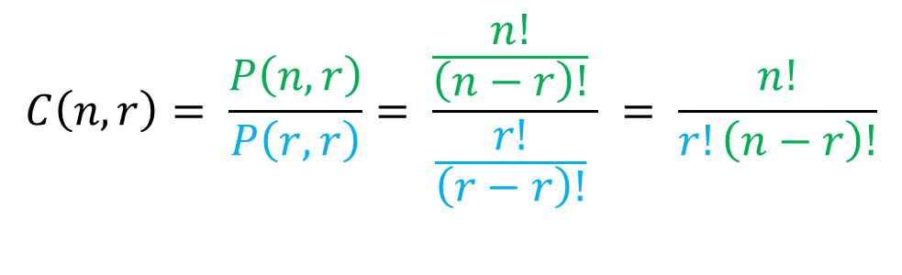
r-Combinations
Permutation
Another way of thinking about it:
$$C\left(n,r\right)= \frac{P\left(n,r\right)}{P\left(r,r\right)}= \frac{\frac{n!}{\left(n−r\right)!} }{\frac{r!}{\left(r−r\right)!} } = \frac{n!}{r!\left(n−r\right)!}$$
Divide out the permutation of each combination

Slide 19
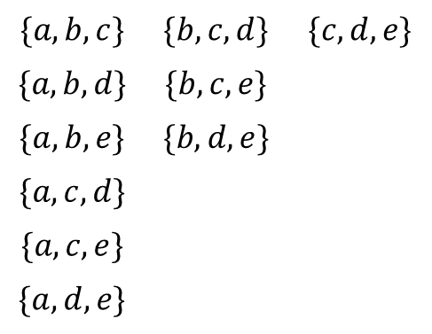
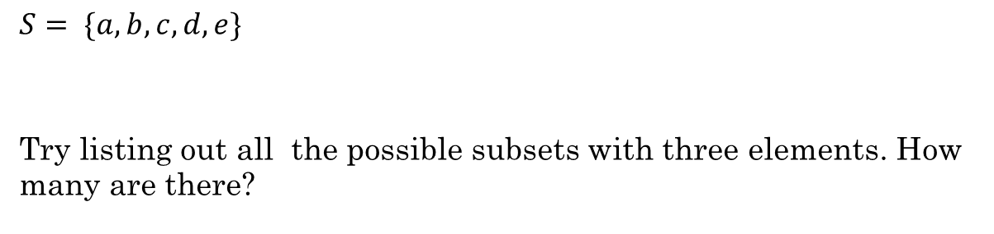
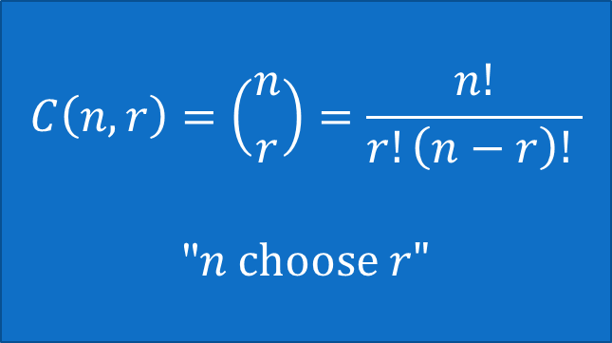
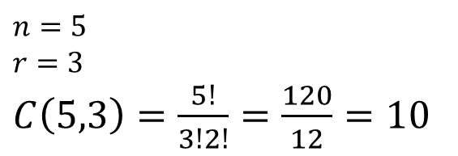
Combinations
$$C\left(n,r\right)=\left({n \atop r}\right)=\frac{n!}{r!\left(n−r\right)! }$$
"$n choose r"$
$S= \{a,b,c,d,e\}$
Try listing out all the possible subsets with three elements. How many are there?
$$\{a,b,c\}$$ | $$\{b,c,d\}$$ | $$\{c,d,e\}$$
$$\{a,b,d\}$$ | $$\{b,c,e\}$$
$$\{a,b,e\}$$ | $$\{b,d,e\}$$
$$\{a,c,d\}$$
$$\{a,c,e\}$$
$$\{a,d,e\}$$
There are 10
$n=5$
$r=3$
$C\left(5,3\right)=\frac{5!}{3!2!}=\frac{120}{12}=10$

Slide 20

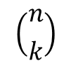
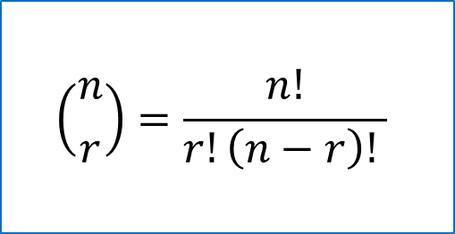
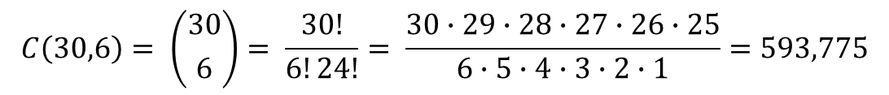
$$\left({n \atop r}\right)=\frac{n!}{r!\left(n−r\right)! }$$
A group of 30 people have been trained as astronauts for the first mission to Mars. How many ways are there to select a crew of 6 people (assuming all 30 people are interchangeable)?
This is the same thing as the number of subsets of 6 elements from a set of 30 elements. Since order does not matter, we use Combinations.
$$\left({n \atop k}\right)$$
$$C\left(30,6\right)= \left({30 \atop 6}\right)= \frac{30!}{6!24!}= \frac{30∙29∙28∙27∙26∙25}{6∙5∙4∙3∙2∙1}=593,775$$
Python
Rosen, Kenneth. Discrete Mathematics and Its Applications, 7th Edition. McGraw-Hill, 2012

Slide 21

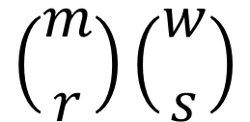
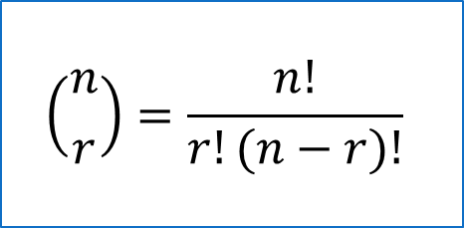
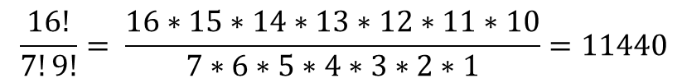
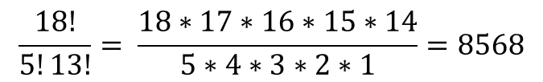
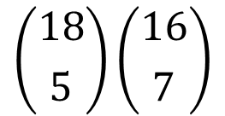
Jury Duty Time!
$$\left({n \atop r}\right)=\frac{n!}{r!(n−r)!}$$
Imagine it is determined that the ideal jury consists of 5 men and 7 women. There are 18 men and 16 women in the jury pool.
How many possible juries are there?
$$\left({m \atop r}\right)\left({w \atop s}\right)$$
$$\left({18 \atop 5}\right)\left({16 \atop 7}\right)$$
98,017,920
$$\frac{18!}{5!13!}= \frac{18∗17∗16∗15∗14}{5∗4∗3∗2∗1}=8568$$
$$\frac{16!}{7!9!}= \frac{16∗15∗14∗13∗12∗11∗10}{7∗6∗5∗4∗3∗2∗1}=11440$$

Slide 22
Additional Exercises:
10.3.1
10.3.2
10.3.3
10.3.4
10.4.2
10.4.3
10.5.1
10.5.2
10.5.3

Slide 23






Dealing with large factorials
$$11$$
$$16$$
$$\frac{33!}{30!3!}$$
$$= \frac{33∗32∗31 ∗30!}{30!∗3!}$$
$$= \frac{33∗32∗31}{3∗2}$$
$$=11∗16∗31=5456$$
Much simpler!

